Slide 1
Shell Bootcamp 2024 3 Reflections for Week 2
Naman Jain
Date : 06-Sep-2024

Slide 2
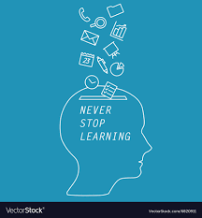
About Me
Never stop learning

Slide 3

My learnings from this week!

Slide 4
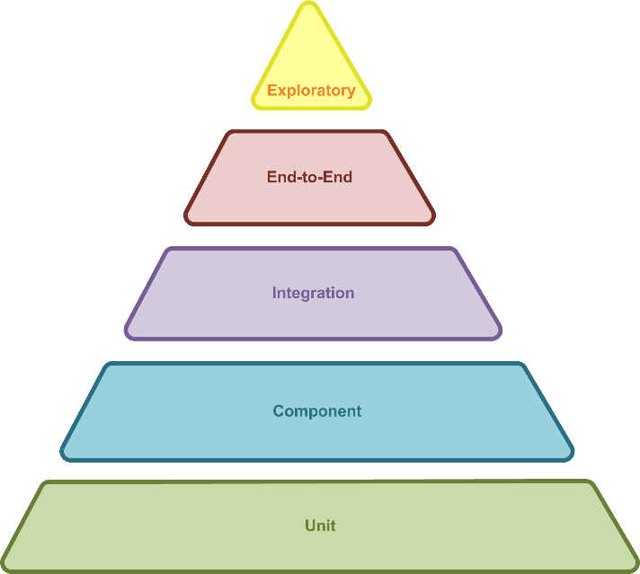
Learning 1 | Software Testing
Software testing is one of the important part of software development life cycle as any bug or default in functionality of an application developed is identified in this stage and reported to the developer team for fixing those bugs.
Functional Testing
Non-Functional Testing
Software Testing Hierarchy
Testing Types: Smoke, regression, performance, Ad hoc, 508 Compliance testing
Ensuring Reliability and Efficiency: Software testing identifies and fixes bugs, optimizes performance, and ensures compliance with industry standards, crucial for managing energy grids and monitoring renewable sources.

Slide 5
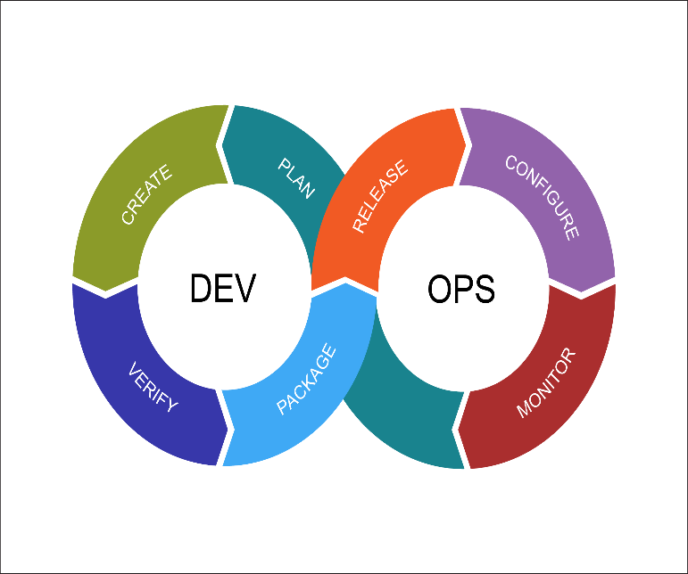
Learning 2 | DevOps
DevOps is essential as it unites development and operations, enabling faster, more reliable software delivery through automation, collaboration, and continuous improvement, leading to innovative and resilient solutions.
Development and Operations
Continuous Integration
Continuous Deployment
Streamlining Operations: DevOps practices can automate and optimize the deployment and management of software systems used in energy production and distribution.
Facilitating Innovation: DevOps enables rapid development and deployment of new technologies, such as smart grids and IoT devices, helping the energy sector adapt to evolving demands and integrate renewable energy sources more effectively.

Slide 6
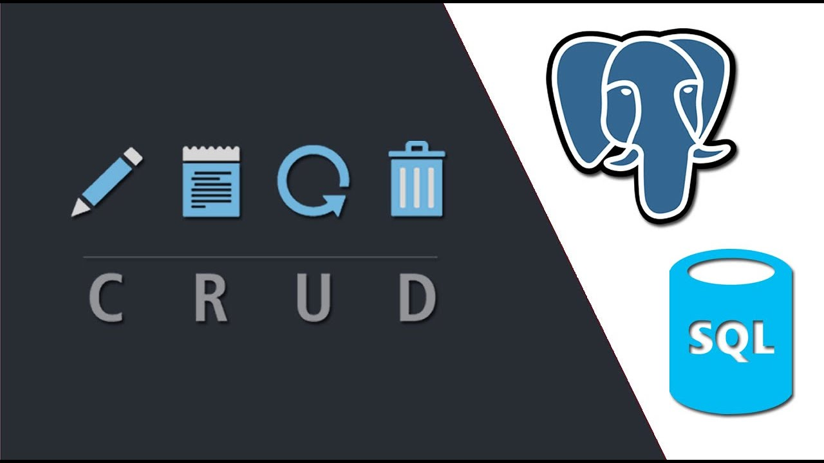
Learning 3 |PostGreSQL
PostgreSQL is a robust, open-source database system that uses Structured Query Language(SQL). It supports complex queries and ensures data integrity, making it great for managing large datasets and delivering reliable performance.
CRUD Operations: Creation, Retrieval, Updation and Deletion
Data Definition Language, Data Manipulation Language, Data Query Language
Data Management and Analysis: PostgreSQL can handle large volumes of data from various sources, such as smart meters and sensors, enabling efficient storage, retrieval, and analysis to optimize energy usage and distribution.
Real-time Monitoring: With its support for complex queries and real-time data processing, PostgreSQL can be used to monitor energy grids.

Slide 7

Relevance of learnings for my organization

Slide 8
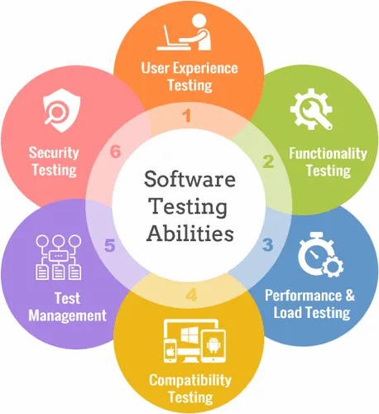
Learning 1 | Relevance for Shell
Rigorous Testing for Reliability: Shell likely conducts extensive testing to identify and fix bugs, optimize performance, and ensure compliance with industry standards, which is crucial for maintaining the stability of their energy systems.
Supporting Innovation: By integrating automated testing and continuous improvement practices, Shell can quickly adapt to new technologies and market demands, ensuring their solutions remain cutting-edge and effective.
Early Defect Detection: Software testing helps identify and fix defects early in the development process. This ensures that Shell’s applications are more reliable and stable, reducing the risk of critical failures in production.
Cost Efficiency: By catching bugs early, software testing helps Shell save on the costs associated with fixing defects later in the development cycle.

Slide 9
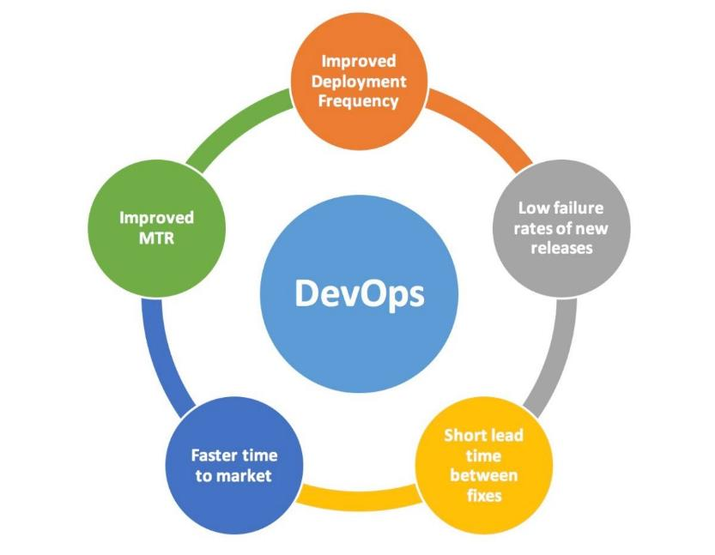
Learning 2 | Relevance for Shell
Continuous Integration and Continuous Delivery (CI/CD): Shell uses CI/CD pipelines to automate code integration and delivery, ensuring faster and more reliable updates.
Agile and Lean Practices: Shell adopts agile and lean methodologies to enhance team collaboration and flexibility, leading to efficient project management and quicker iterations.
Enhanced Efficiency: By adopting CI/CD and agile practices, Shell can streamline its development processes, leading to faster delivery of updates and new features.
Improved Collaboration: DevOps fosters better communication and collaboration between development and operations teams, resulting in more cohesive and effective project management.

Slide 10
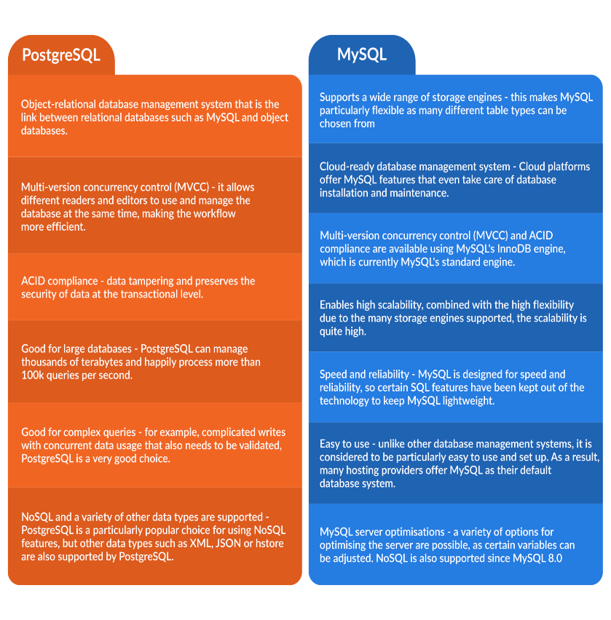
Learning 3 | Relevance for Shell
Data Management and Storage: Shell uses PostgreSQL for managing and storing large volumes of structured data. This helps in maintaining data integrity and supports complex queries and transactions efficiently.
Integration with Applications: PostgreSQL is integrated with various applications and services within Shell, enabling seamless data flow and real-time analytics. This integration supports decision-making processes and operational efficiency.
Scalability and Performance: PostgreSQL excels at handling large volumes of data and concurrent transactions efficiently, making it ideal for Shell’s high-demand environments.
Advanced Data Management: PostgreSQL’s robust feature set, including support for complex queries, data types, and full-text search, allows Shell to manage and analyze data effectively.

Slide 11

Challenges in implementing learning

Slide 12
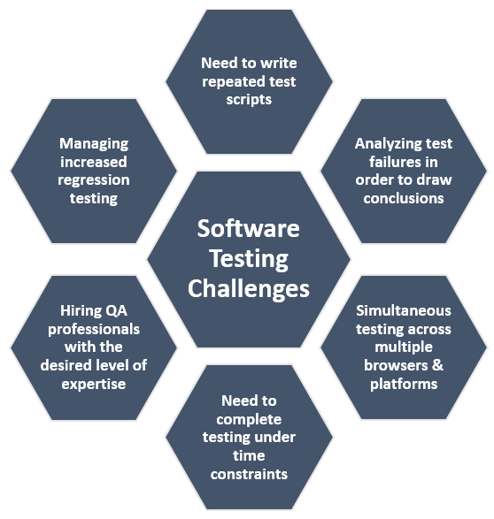
Challenge faced while implementing Learning 1
Difficulties
I faced some difficulties in making the test cases which need to be detailed for every action/step.
Reporting/ finding a bug was another issue that I faced because it was a bit difficult for some functionalities to define whether those were documented or not.
Overcoming
I will overcome these by making multiple test cases and bug reports on different websites

Slide 13
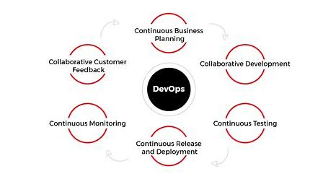
Challenge faced while implementing Learning 2
Difficulties:
I faced this learning a bit different as it was a bit challenging to set up the pipeline as multiple files were needed to be configured to run the deployment successfully.
Overcoming:
I practiced making the pipeline in Github which I ran on an Azure Virtual Machine and this hand on helped me to learn the concept in much more depth.

Slide 14
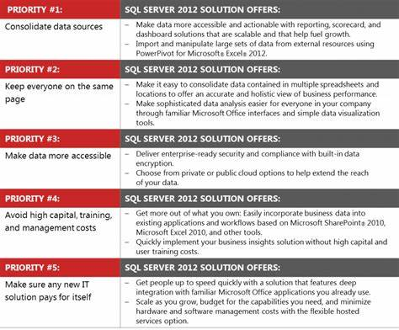
Challenge faced while implementing Learning 3
Challenges:
Efficient CRUD operations implementation and how each operation is different from other
Revisiting the SQL basics as I didn’t get the time for that.
Overcoming:
Going through the SQL basics and practicing query.

Slide 15

Action Plan

Slide 16
My Action Plan for this Week
Actions
Timeline
Status
Test case development and bug report practice.
Practicing SQL queries.
Configuration of Virtual Machines and its usage
Saturday: Test case and sql queries
Sunday: Gain more knowledge and revisiting the concepts
Will be completed by the end of week

Slide 17

Learning is also Fun!

Slide 18
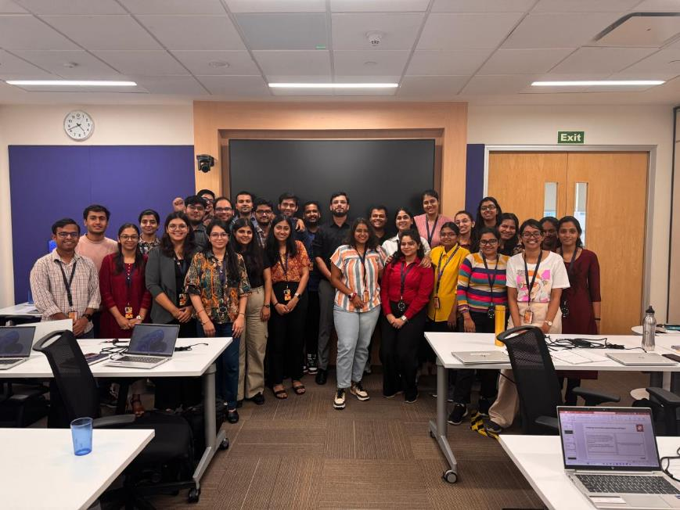
Learning is also Fun!
The technical session were full of information along with the real-life stories of the Mr. Mohammad Sohel Abbasi which helps us to understand the concepts not just theoretically but also practically. His real-life incidents mapped to the theoretical concepts made a significant amount increase in my knowledge.
[Add a graphic or a picture of how you/your team enjoyed the new learning]

Slide 19

Summary
The overall sessions were very knowledgeable and filled with creative way of teaching.
CI/CD pipeline using GitHub actions is very necessary to automate the process and make the process efficient and less time consuming.
PostGreSQL is a relational database management system which implement structured query language.
Software testing is one of the important part of software development life cycle as any bug or default in functionality of an application developed is identified in this stage and reported to the developer team for fixing those bugs.

Slide 20
Thank You

